Slide 1

Welcome to EcoGram!
Inspire, Act, Change
Team Members
Divya Myneni -002746471
Sai Veerendra Prathipati -002781739
Lakshmi Anchitha Panchaparvala -002643844
Sai Pravallika Balina -002642253

Slide 2
Problem Statement
Lack of inclusive platforms that hinders the sharing of ideas among individuals and
communities engaged in sustainable living and environmental activism.
Result/ Consequences
The Limited exchange of diverse perspectives
Decreased collaboration and synergy
Missed opportunities for innovation and action.

Slide 3
Solution
Inclusive Community Building
Engaging Content Creation
Knowledge Exchange and Peer Learning
Networking and Collaboration

Slide 4
Design System
Introduction:
Our Design System adheres to the principles and guidelines set forth by Google's Material Design. This system encompasses a harmonious blend of colors, fonts, icons, screen layout dimensions, and a distinctive logo. By following these guidelines, we ensure a consistent and visually pleasing user experience across our digital products.
Colors:
Our color palette is inspired by Google's Material Design color system. It consists of primary, secondary, and accent colors that convey a sense of hierarchy and interactivity. The primary color establishes the overall tone, while secondary and accent colors add depth and emphasize key elements. These colors are carefully chosen to evoke emotions and enhance usability.
Primary Color: #FFFFFF
Secondary Color: #1B2E10
Accent Color: #CACCAC, #D5E7C8

Slide 5
Design System
Fonts:
Typography plays a pivotal role in user communication. We employ Google's recommended fonts to ensure legibility and aesthetics.
Icons:
Icons are essential for conveying information quickly and intuitively. We utilize a library of icons following Google's Material Design icons. These icons maintain a consistent visual language that enhances the user's ability to understand and navigate our products.
Dimensions of Screen Layout:
Our screen layout dimensions are designed to be responsive and adaptable, catering to various devices and screen sizes. We follow Google's responsive layout guidelines to ensure that our content remains visually appealing and accessible across different platforms.
Mobile Layout: 393 x 852

Slide 6
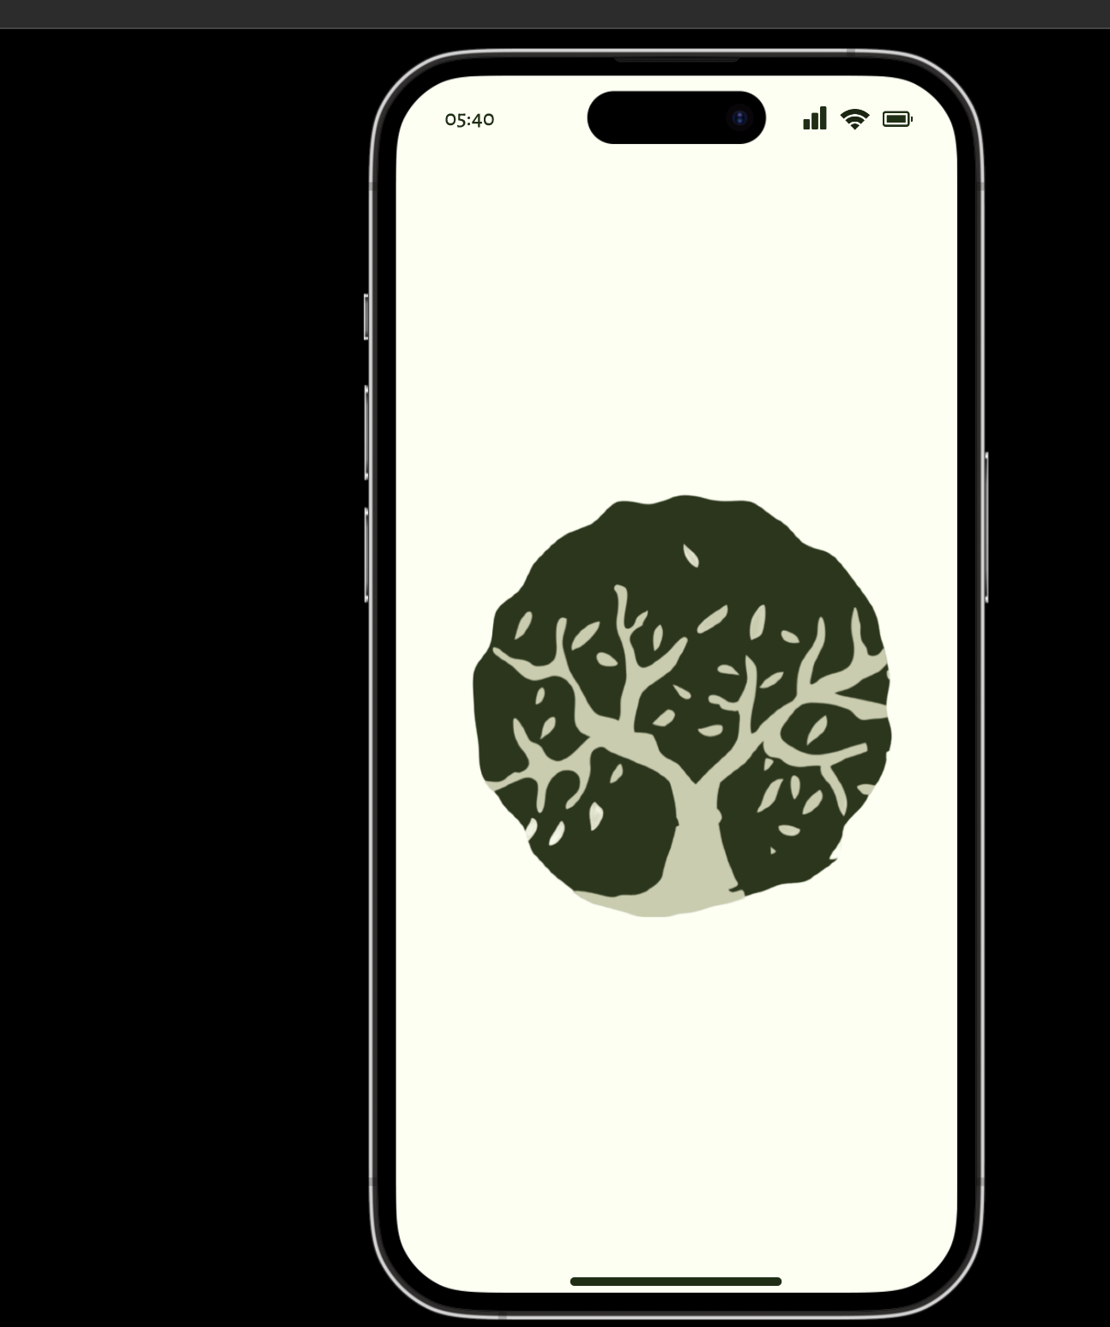
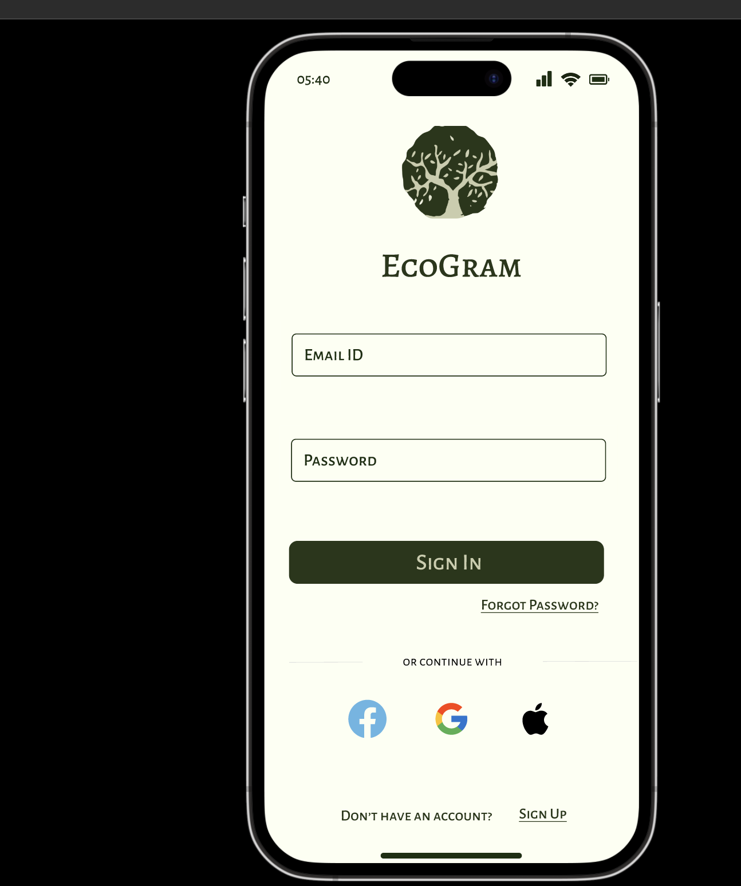
Design System
Topbar dimensions
393 x 55
Primary Color #FFFFFF Background Color
LOGO
Screen Dimensions
Iphone 14 pro frame 393 X 852
#CACCAC
Secondary Color
Used for Background color
Secondary Color
#1B2E10
Heading, sub-heading Color

Slide 7
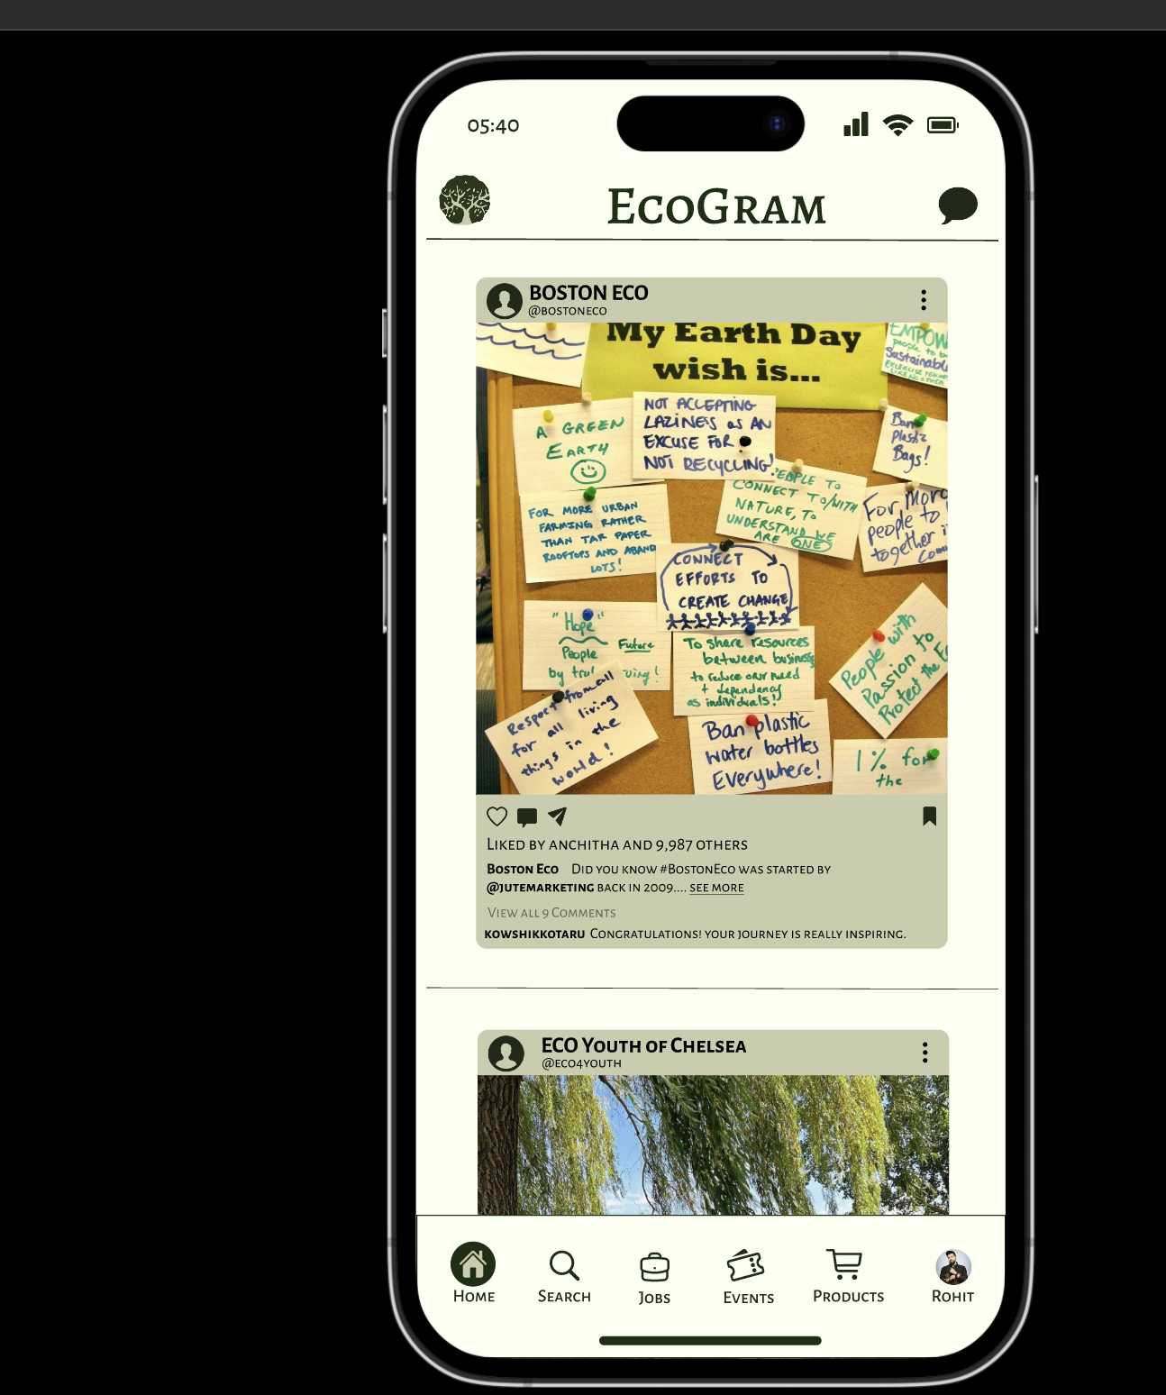
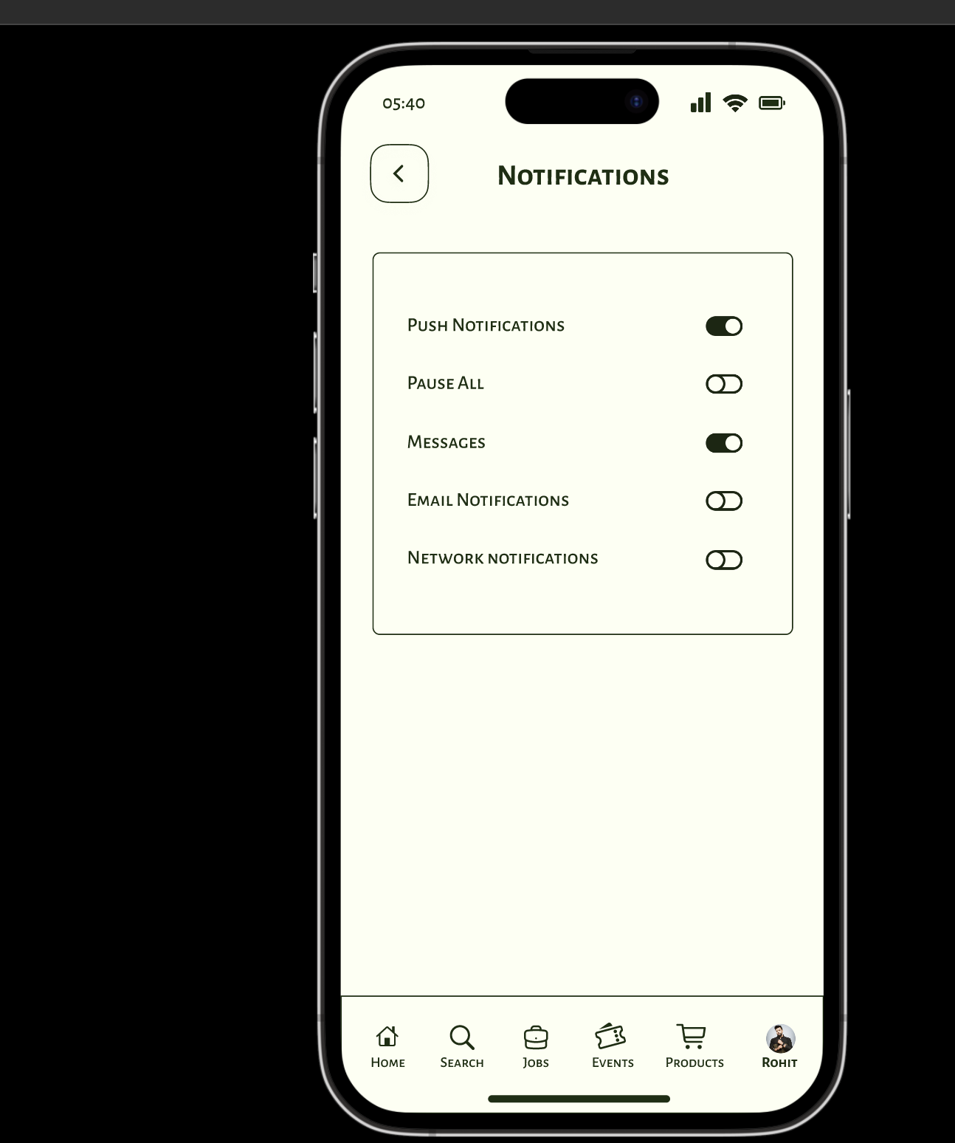
Design System
Back Icon
To Navigate to previous screens
#1B2E10
For toggle on switch
Nav Bar
Profile Icon
To see and edit profile
#FFFFFF
For toggle off switch
Nav Bar
Products Icon
To see all available Products
Nav Bar
Events Icon
To see all events happening
Nav Bar
Jobs Icon
To see all jobs posted
Nav bar dimensions
393 x 96
Nav Bar
Search Icon
To search all users
Nav Bar
Home Icon
To see all posts by all users

Slide 8
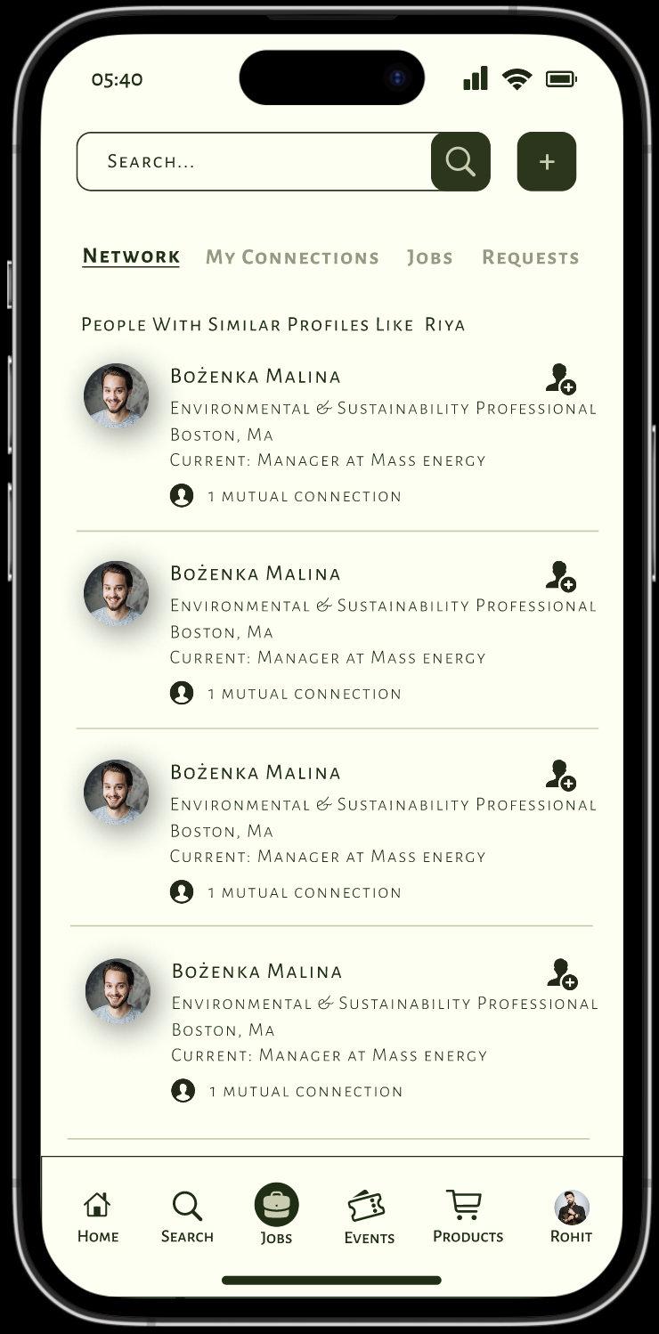
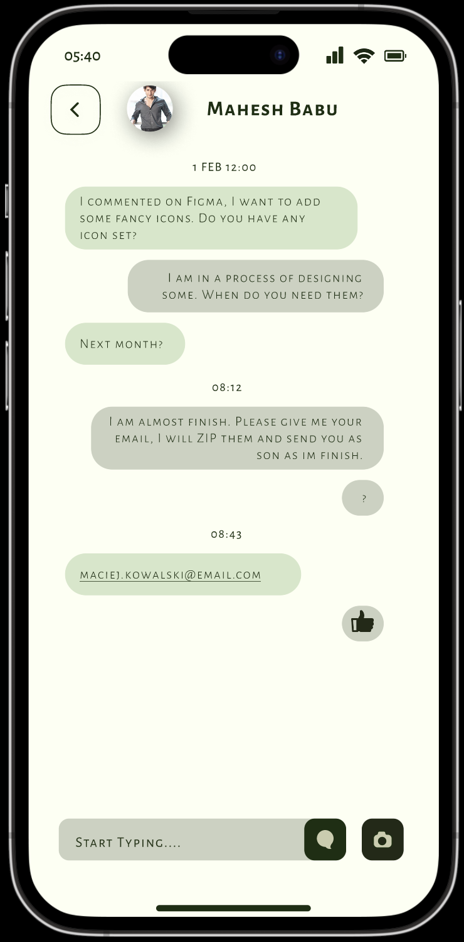
Design System
Add Icon
To add new connections
#000000
Used for borders
Secondary color
Used for texts
Request Icon
To sent connections request
Person Icon
To see all mutual connections
Camera Icon
To sent or click new Images

Slide 9
Product Objectives
Foster Niche Communities
Encourage Authenticity
Enhance Privacy and Security
Facilitate Content Sharing
Promote Meaningful Interactions
Personalized User Experience
Support Collaboration and Networking
Seamless Cross-Platform Integration

Slide 10
Target Audience
Eco-Enthusiasts, Activists, and Sustainable Businesses:
Connect and empower individuals passionate about sustainability.
Foster collaboration, knowledge sharing, and networking.
Educators/Experts and Conscious Consumers:
Connect educators, experts, and conscious consumers.
Inspire and drive positive change towards sustainability.
Environmental Organizations/Non-profits:
Amplify the impact of environmental organizations.
Provide tools and resources for effective advocacy.

Slide 11
Design Process
Product Definition
Research
Analysis
Design
Validation
Understand user needs and challenges
Collect data through research, surveys, and interviews.
Clearly state the app's purpose and goals.
Create profiles of typical users
Generate creative ideas and features.
Collaborate with the team for innovative solutions.
Create basic sketches or wireframes
Develop interactive prototypes for user testing
Make improvements based on feedback
Have users try out the prototype

Slide 12
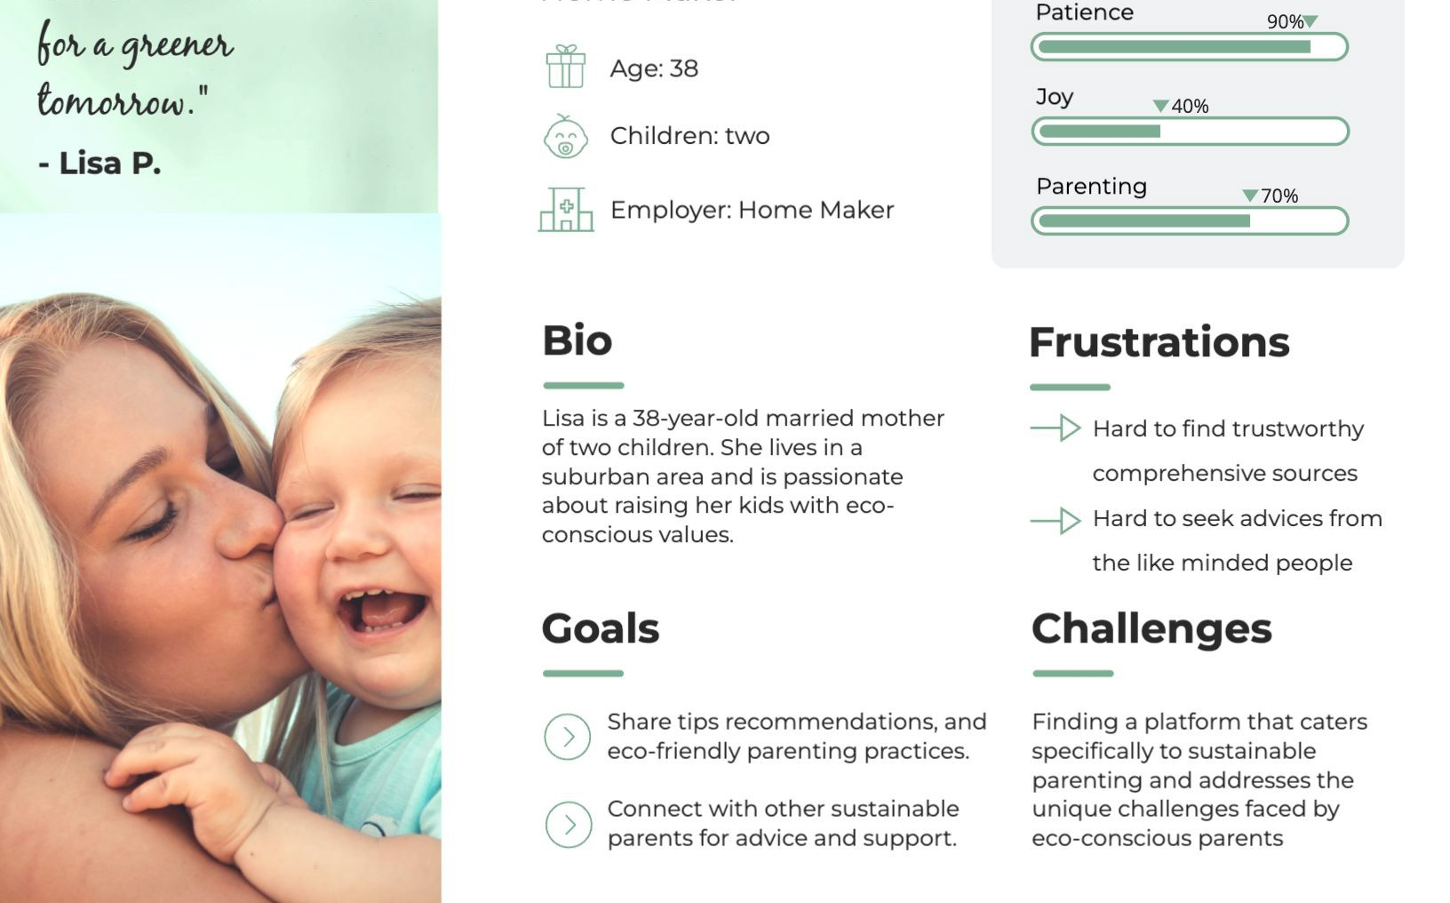

Slide 13
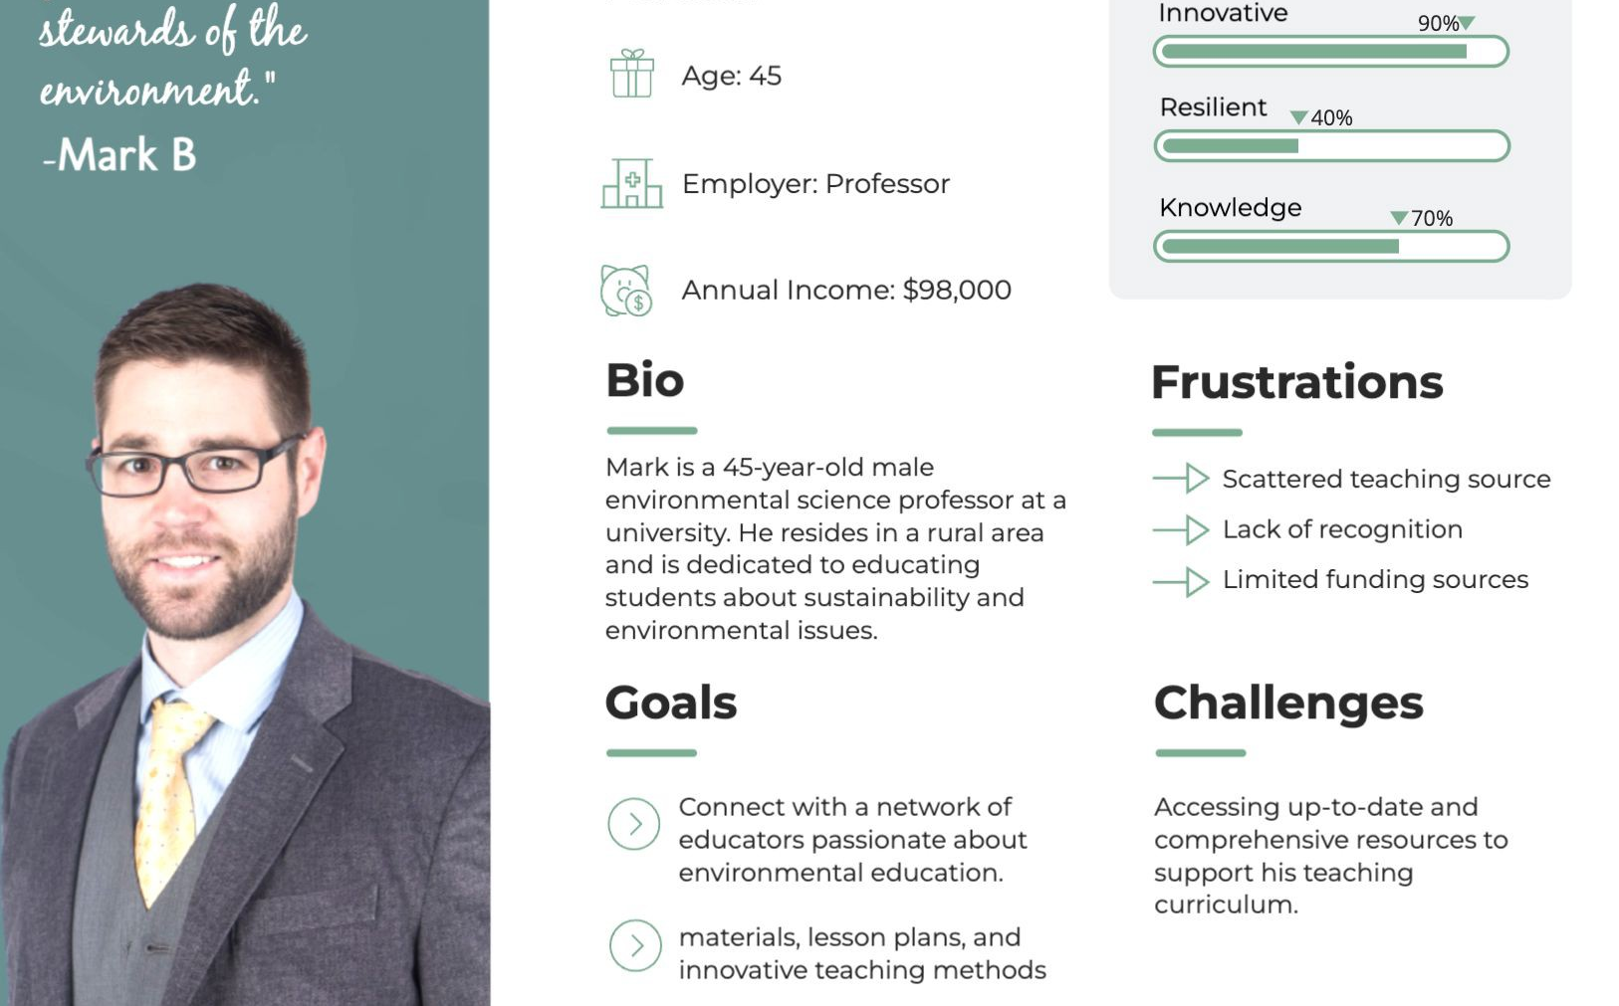

Slide 14
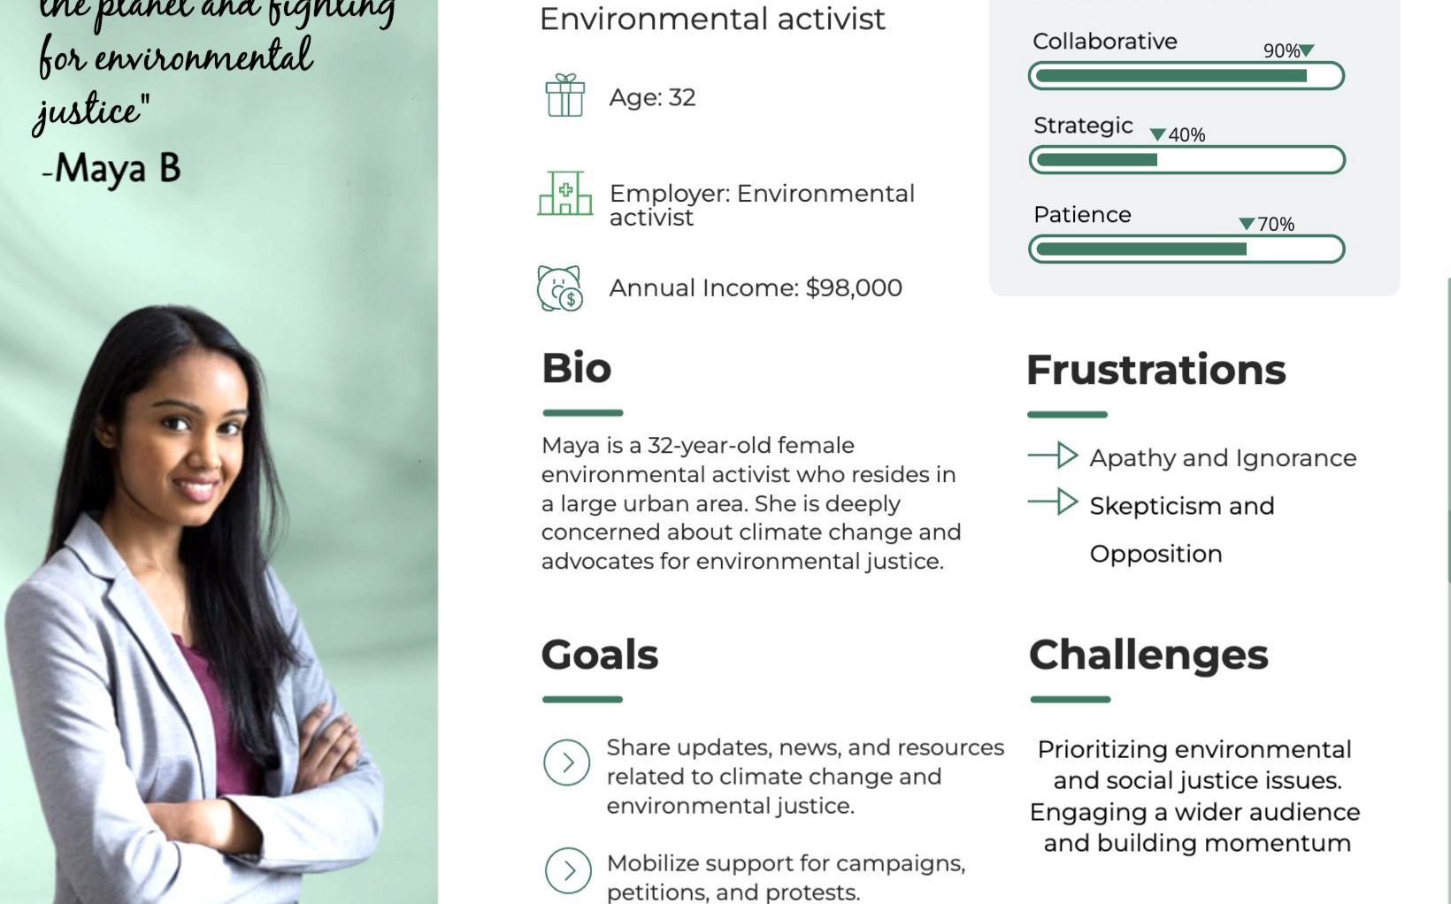

Slide 15
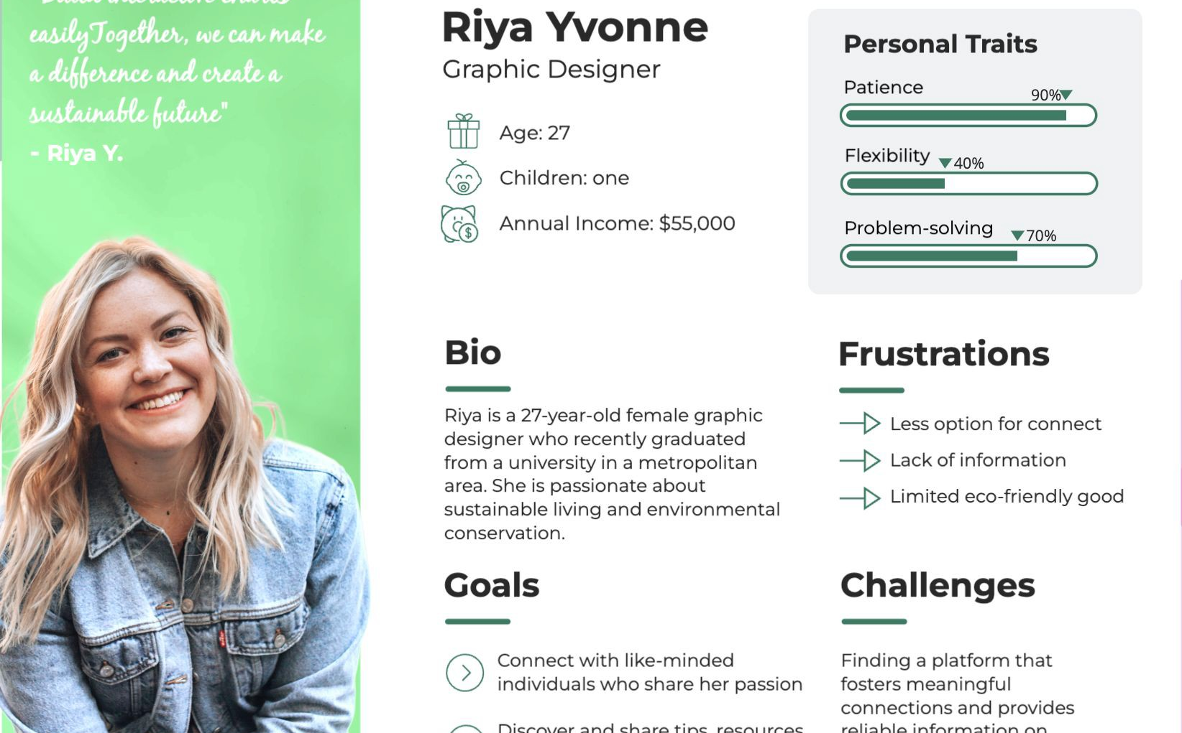

Slide 16
User Needs
Community Connection
Individual Expression
Inspiring Content
Privacy Control
Smooth User Experience
Engaging Interactions
Professional Networking
Flexibility and Accessibility
Quality Content

Slide 17
User Research Methods Used
User Interview
User interviews are fast and easy. We can use them to learn about users’ perceptions of the design.
User persona creation
A user persona is a semi-fictional character based on the current (or ideal) customer.

Slide 18
User Interview
The team reached out to our family and friends to ask them questions on what kind of features would they like to see this app. The pool was quite varied and consisted of people in their teens to old age, this provided us with an array of perspectives on what was needed from the app.
Because of the interviews we were able to better understand what our potential users needed from the app and we gathered some guidance points which shaped the design.

Slide 19
User Persona Creation
From the user interview we had worked on we had basic understanding of what the user needs were from a this app. We then used these objectives to create multiple fictional to make the needs easily relatable to the team members.
Because of the user personas we were able to understand our users’ needs better and make sure that the design of the app can cater to the needs of such personas in real life use cases.

Slide 20
Open Card Sorting
User-driven Categories: Users freely categorize cards, revealing preferred groupings and potential category names.
Complex Interpretation: Results can be intricate due to varied user choices, requiring careful analysis.
Closed Card Sorting
The Quick Structure Check: Rapidly assesses existing categories for user-friendliness.
Validation via Closed Sort Report: Confirms category appropriateness, enhancing user experience.

Slide 21
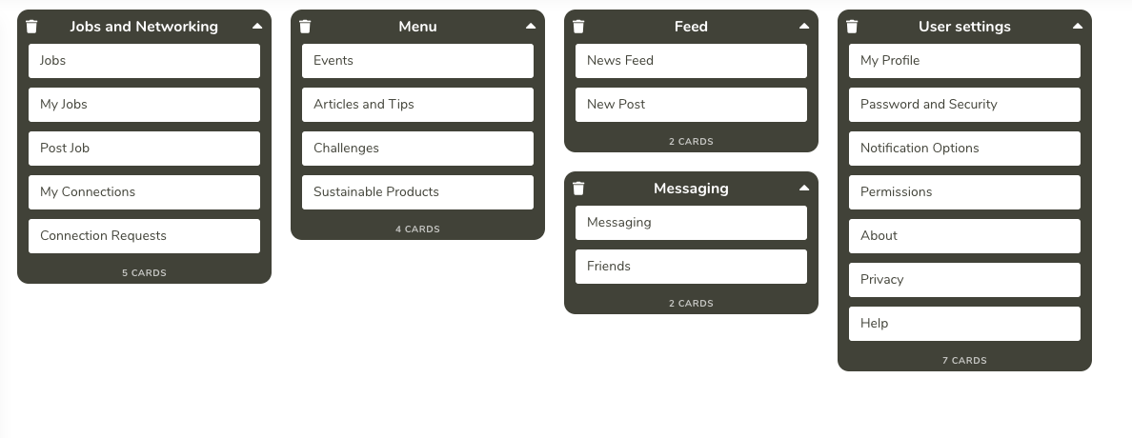
Iterations for Open Card Sorting
Participant 1:

Slide 22
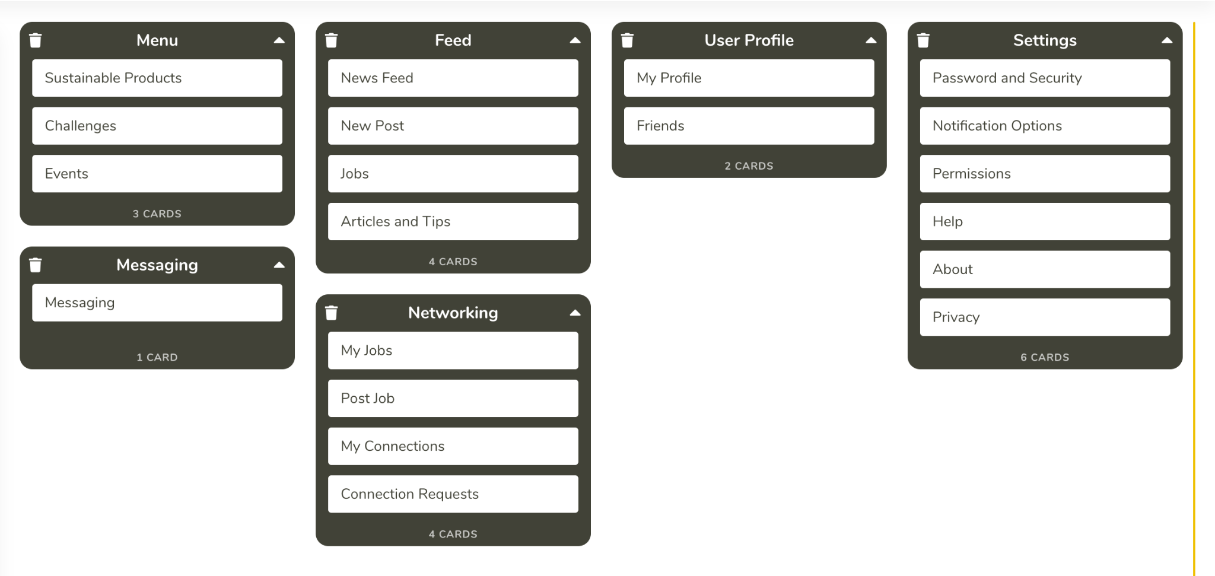
Iterations for Open Card Sorting
Participant 2:

Slide 23
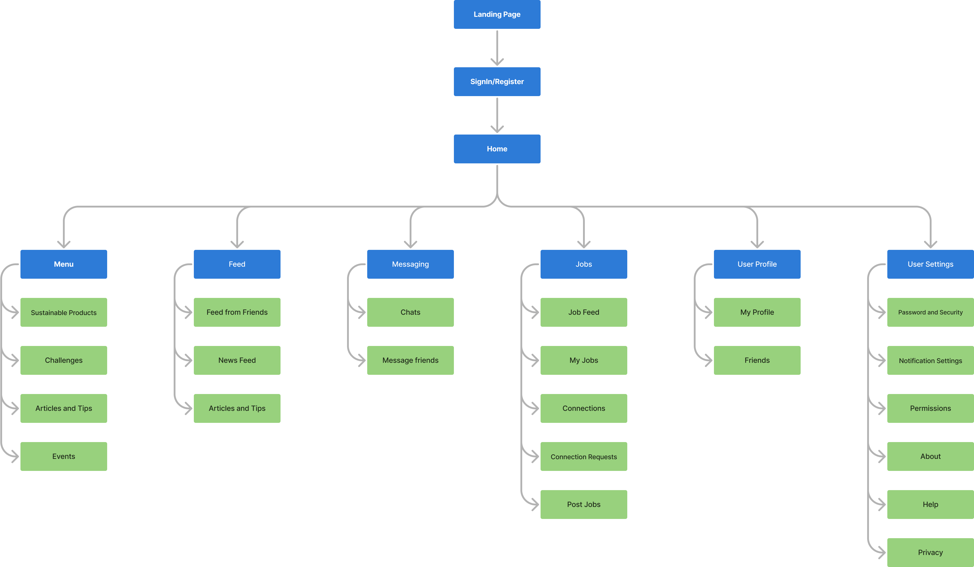
Information architecture for open card sorting

Slide 24
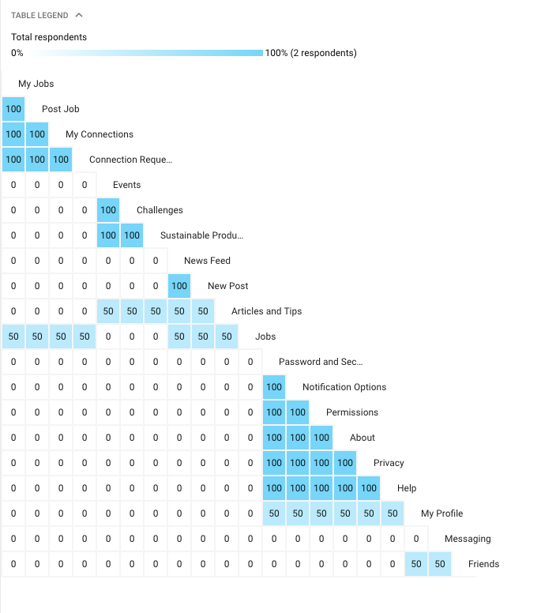

Slide 25
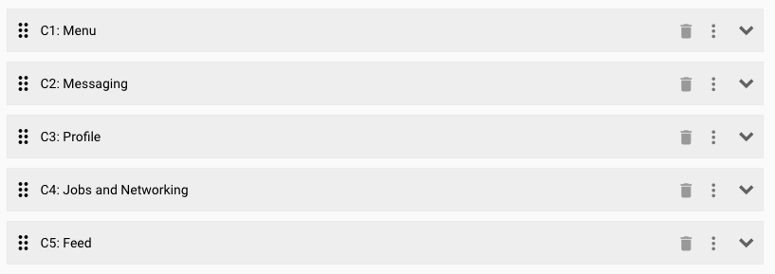

Slide 26
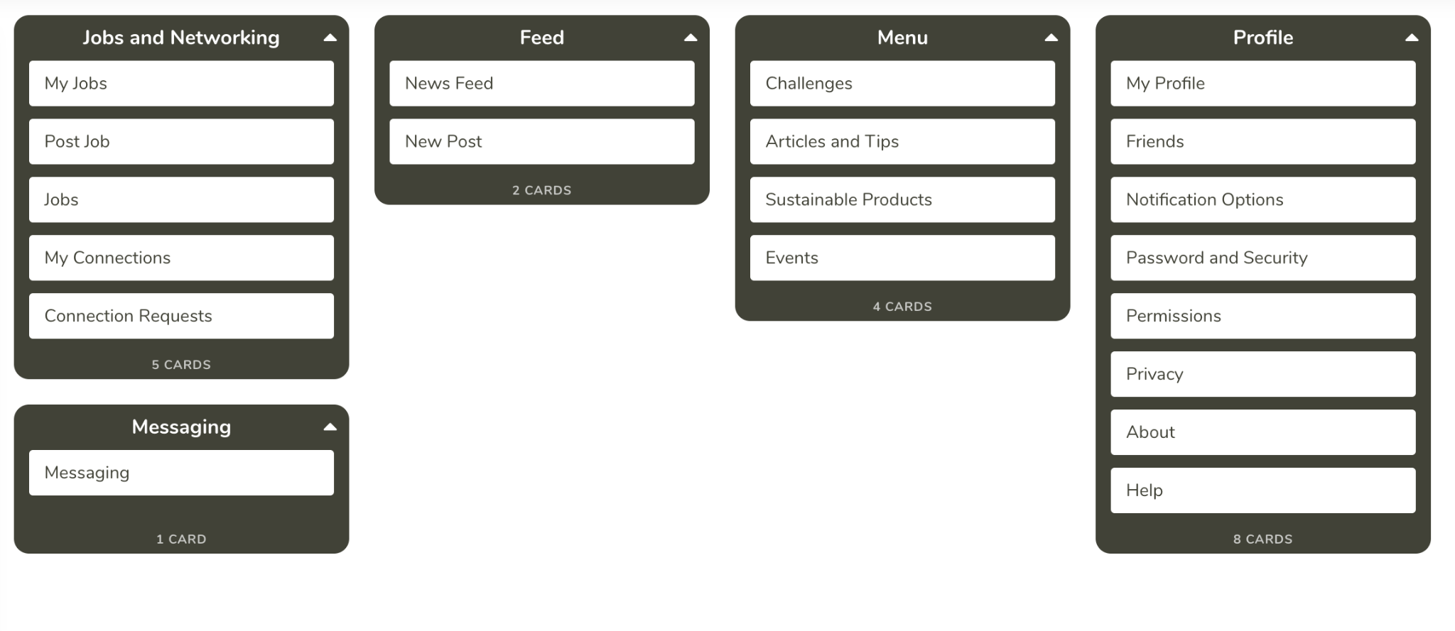
Iterations for Closed Card Sorting
Participant 1:

Slide 27
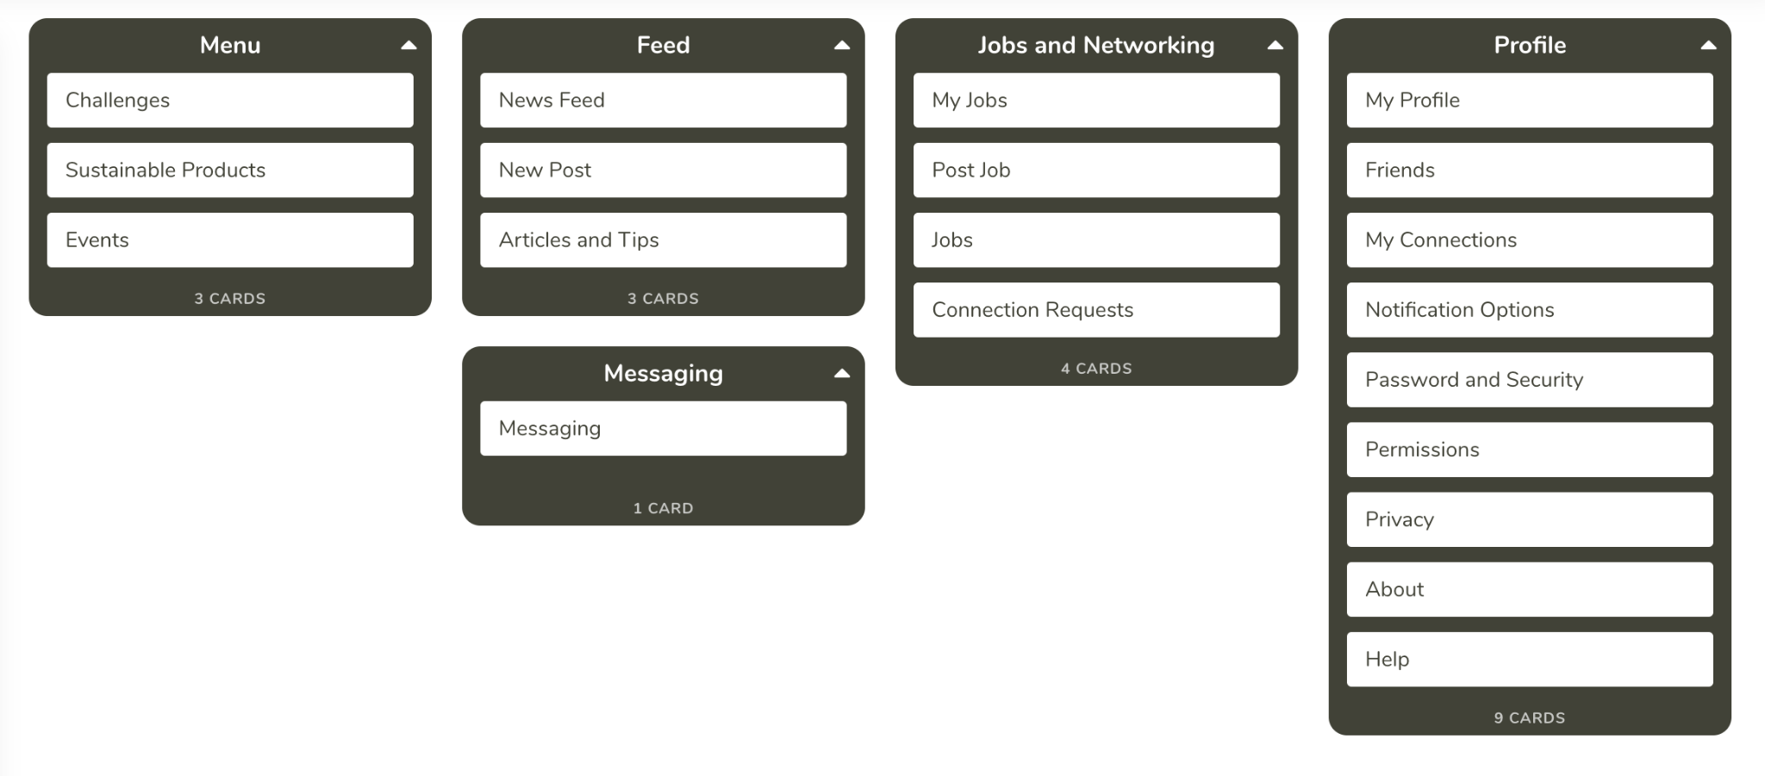
Iterations for Closed Card Sorting
Participant 2:

Slide 28
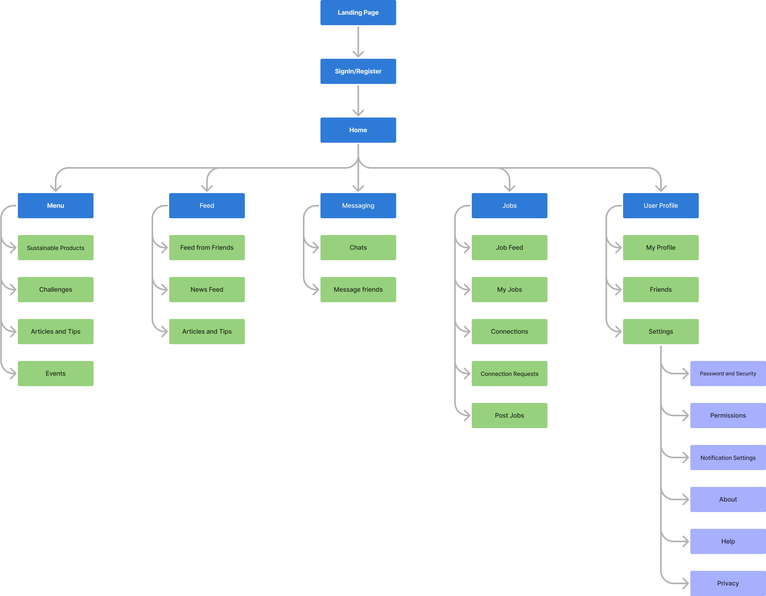
Information architecture for closed card sorting

Slide 29
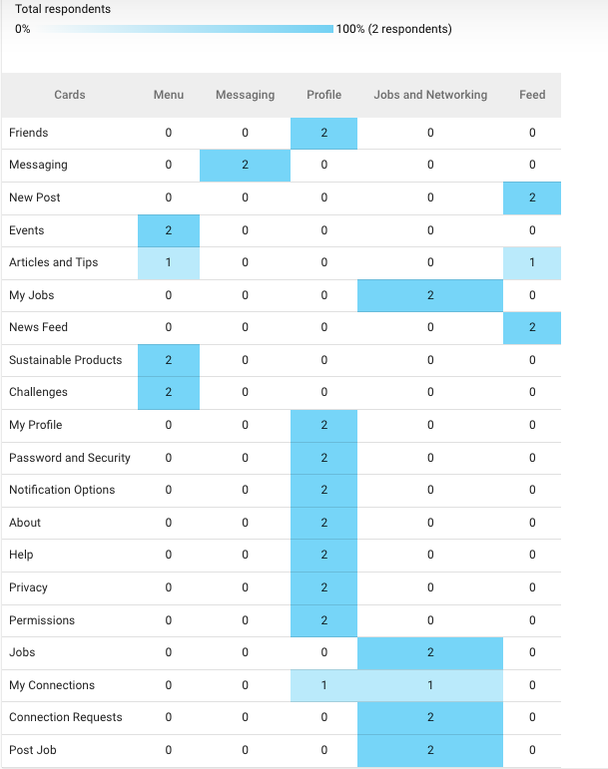

Slide 30
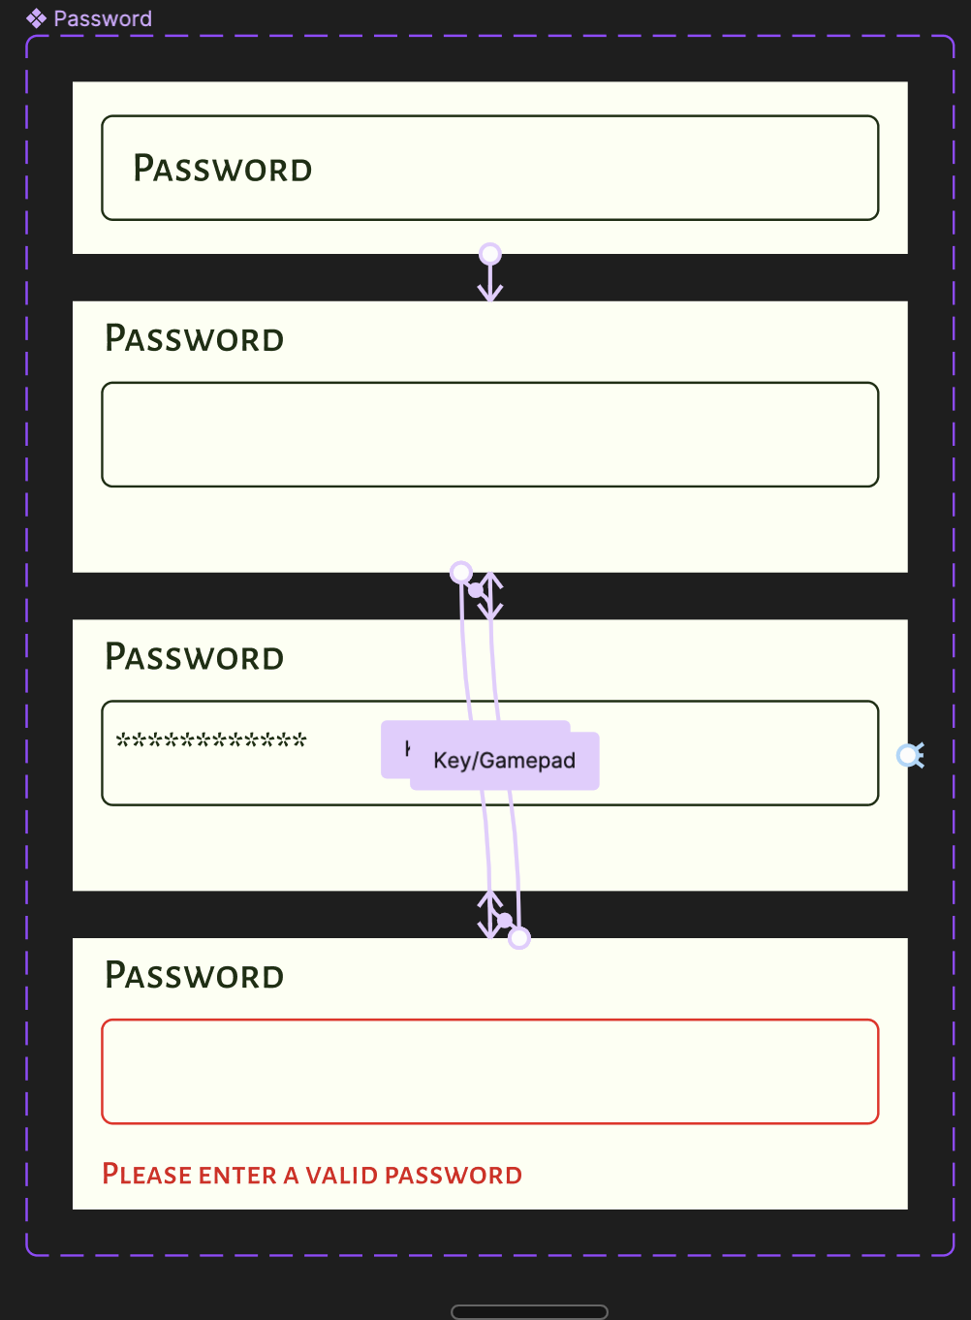
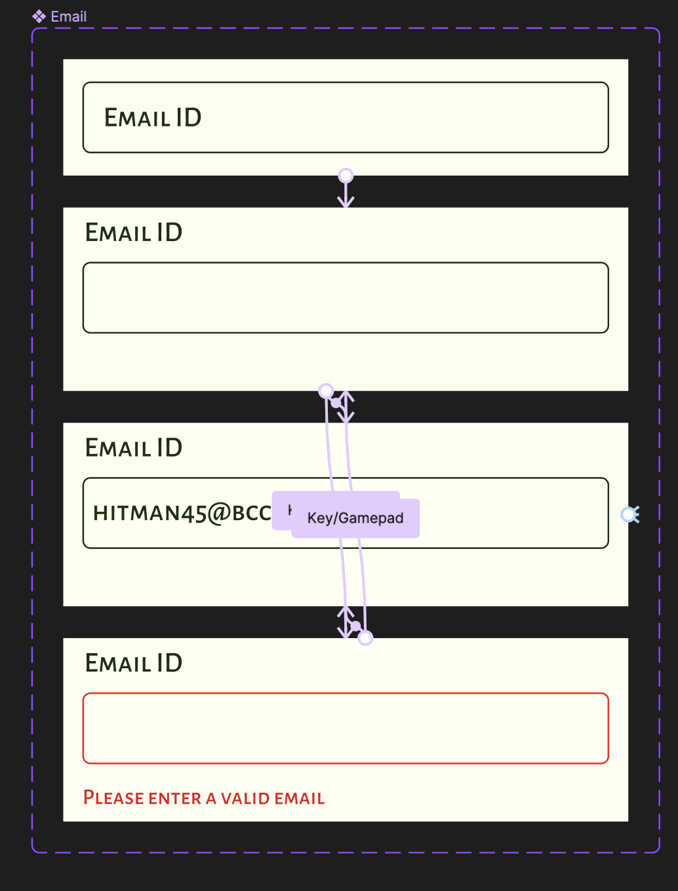
Error Handling:
Created input fields with the requirements
Added to the Signup, Login, Forgot and reset screens.
The last variant displaying the Error-Pop-out
Interactions added with the Key/Gamepad
True value=“h”
False value=“Blankspace”

Slide 31
Usability Testing objectives and tasks
Open-Ended Tasks:
Explore Sustainable Posts:
Browse visual posts and articles to discover sustainable content; compare differences and engagement.
Share Your Eco-Achievement:
Create post and article about sustainable achievement; compare experiences and challenges.
Participate in a Sustainability Discussion:
Contribute to discussion with comments and article references; assess impact on interaction quality.
Find Inspirational Stories:
Search for inspiring sustainable stories in visual posts and articles; compare impact of presentation.

Slide 32
Usability Testing objectives and tasks
Closed-Ended Tasks:
Set Up your Sustainable profile:
Customize profile, rate ease of setup
Follow Sustainability Influencers:
Follow influencer, subscribe to article notifications; assess ease
Manage Notifications and Respond:
Check and respond to the notifications for the posts, articles and assess ease.

Slide 33
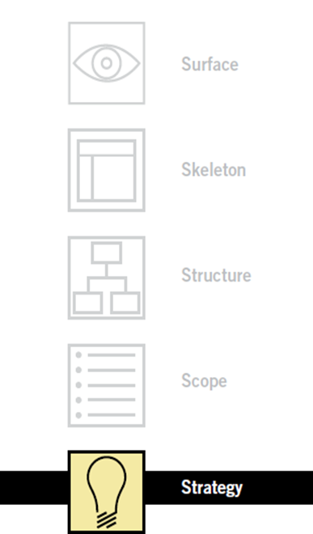
Strategy Plane -Why?
•Product objectives and user needs form the strategy plane- foundation for UX.
•Using strategy plane, we started with defining our product objectives in a simple way which is: To create a platform for sustainable living enthusiasts where it enables meaningful interactions as well as seamless cross-functional integration.
•Also, one of the important aspect of defining product objectives is setting some success metrics and we have chosen
number of user registrations per month.
•Next, we defined our user needs- first by deciding who are our users, then segmented based on psychographic segmentation,technical exposure,location and age segmentation.
To understand their needs better, we tried understanding them first by conducting User Research and user methods like card sorting, Diary studies, tree sorting.

Slide 34
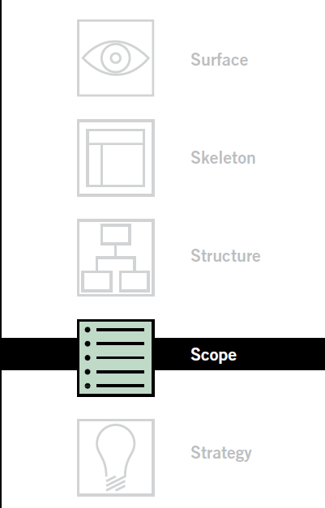
Scope Plane-What?
Strategy becomes scope when we translate user needs and product objectives into specific requirements
After defining the requirements, the next step is to prioritize and there are so many ways to do that.
For our project we have chosen MoSCoW technique to prioritize our requirements.
MoSCoW:
Must-have: Account creation, Job portal, Chat portal, search bar
Should-have: articles, products, on-boarding
Could-have: Events
Won’t-have: Short videos, AI-based features

Slide 35
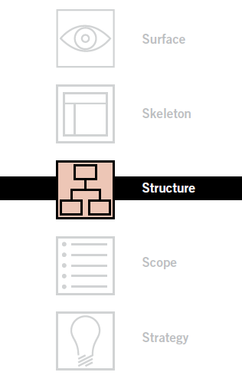
Structure Plane-How?
Structure plane deals with defining patterns and sequences in which options will be presented to users, which will be intuitive.
One of most important aspect of Structure plane is error handling, which we have incorporated in our project
The backbone to the informational architecture is organizing principles and in our project we arranged our components according to them.
For example, we grouped all of the components based on the broad features like jobs, posts, events, products.
Notes:
,

Slide 36
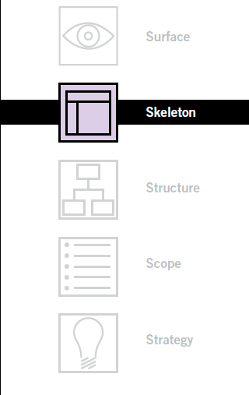
Skeleton Plane
The skeleton plane defines what form that
functionality will take.
On structure plane, we looked at the large-scale issues but in skeleton plane we will see smaller components and their relationships.
3 main components of structural plane- Interface design, navigational design, information design
In our project, in some areas we sticked with the conventions like sign up page, forgot password, posting articles.
Also, we mainly focused on the interface design and navigational design
Interface design-we highlighted important buttons by color variation.
Under navigational design we have chosen both global and local navigation

Slide 37
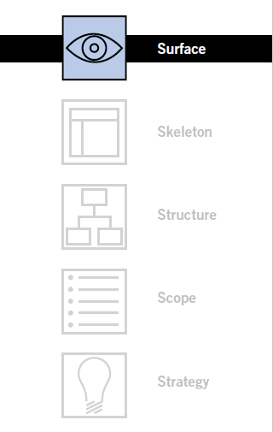
Surface Plane
Moving up to the surface plane, we are now dealing with the sensory design
In our project, we used some of the principles of visual design aspect of the surface plane, like:
Contrast and uniformity-by choosing off-white and green as our colors which are contrast and we maintained the uniformity throughout our app.
Typography
Style guides

Slide 38
Wireframe Demo
https://www.figma.com/file/ZhVJNS1GB6Kwe3SZ4qQ0LG/Final-Project?type=design&node-id=110-1580&mode=design&t=ebGfjtNUKFvGVzx1-0

Slide 39
Thank You

